Slide 1
Housing Sales Price Analysis
By : Sheel Vohra

Slide 2
Objective
Finding the coefficient of determination between a multivariable housing dataset by using multiple linear regression model.

Slide 3
Background
Dataset is acquired from Kaggle
Target variable is Sale Price of the homes
79 other variables with 1460 rows

Slide 4
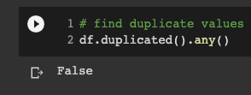
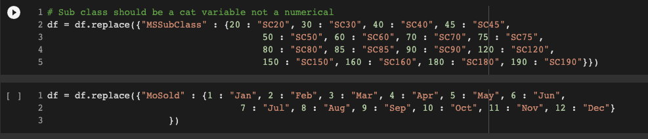
Data Cleaning
The data set is lacking any duplicate values
Some columns are misinputed as numerical data

Slide 5
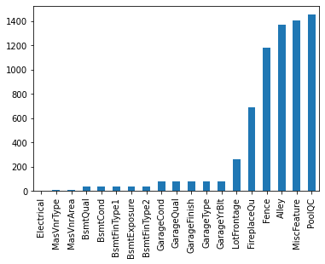
Handling Null Values
Null values need to be filled
Missing data represents what the house lacking
This will have an influence on price
Filled value with “None” or 0 when appropriate

Slide 6
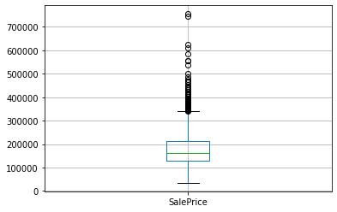
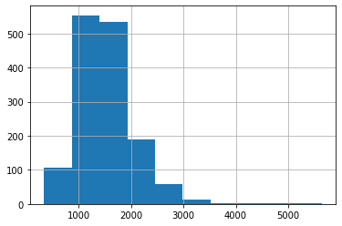
Visualizations
Box plot and Histogram of ‘SalePrice’
This is the target variable that will be studied
There are a lot of outliers
Majority of data is mainly around 200,000 houses

Slide 7
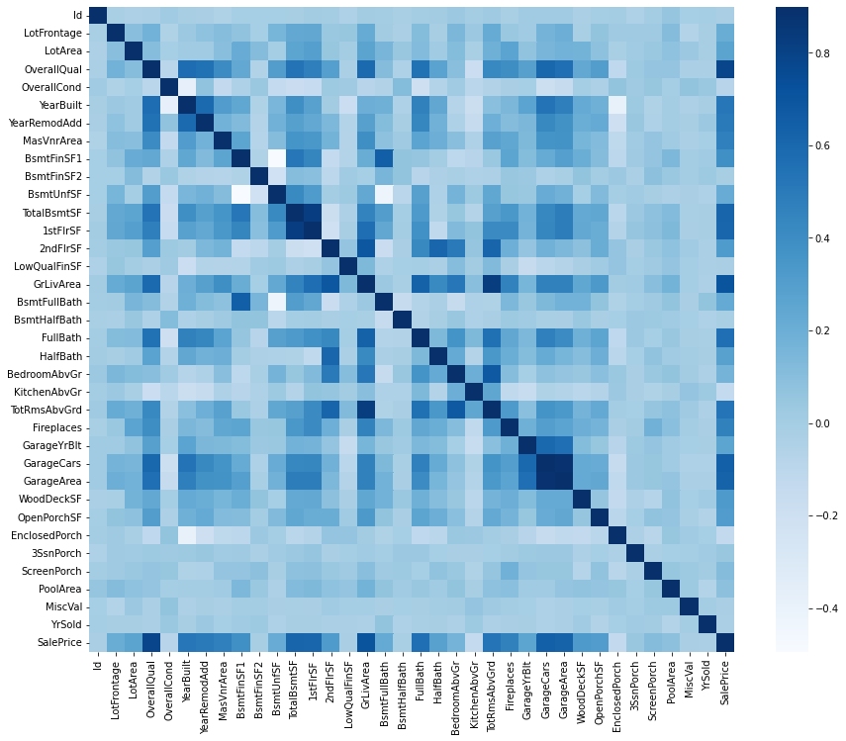
Correlation
Highest correlating variables are OverallQual and GrLivArea
OverallQual is the quality of the materials used in the house
GrLivArea is the square footage above ground
A lot of the numeric data is not highly correlated with the price

Slide 8
Challenges
A lot of missing values in different columns
Large dataset
Unfamiliar terminology

